Slide 1

Where In The Universe Is Classroom 205?!?
Notes:
This presentation was created for the final presentation for my Software Engineering class at URI. This was never given, but I have fun using the animations and tools available through Microsoft. My team was designing and writing a video game based on the premise that the smart board creates and alternate reality when the teacher accidentally writes a division by 0 on the board. This short is intended as the intro to be played to set the scene for the player. The entire presentation plays itself once launched. The last slide is intended as the layout for the gameplay menu.

Slide 2


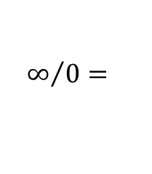
It was just another hum-drum day in class
WHEN ALL OF A SUDDEN….
$$∞/0=$$
Notes:
https://www.istockphoto.com/photos/classroom?phrase=classroom&excludenudity=true&sort=best

Slide 3
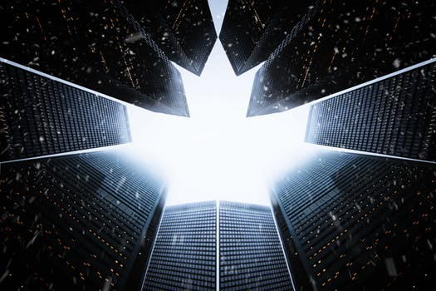
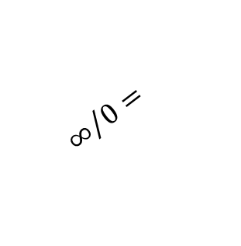
$$∞/0=$$
Notes:
https://www.istockphoto.com/photos/classroom?phrase=classroom&excludenudity=true&sort=best
https://www.pexels.com/search/space/

Slide 4
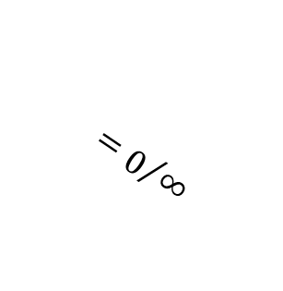
$$∞/0=$$
Notes:
https://www.istockphoto.com/photos/classroom?phrase=classroom&excludenudity=true&sort=best

Slide 5
No one Knew What Happened

Slide 6
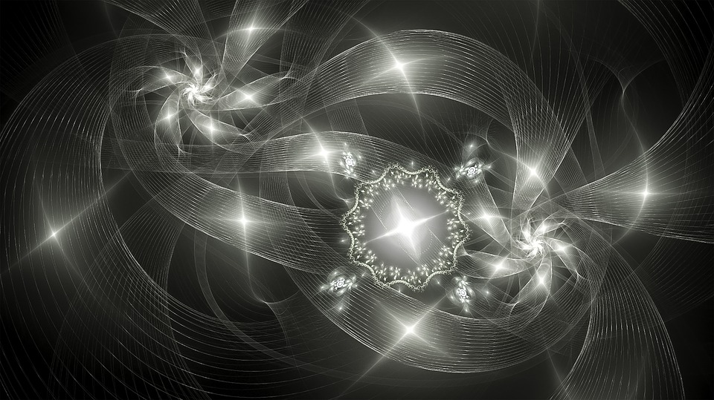
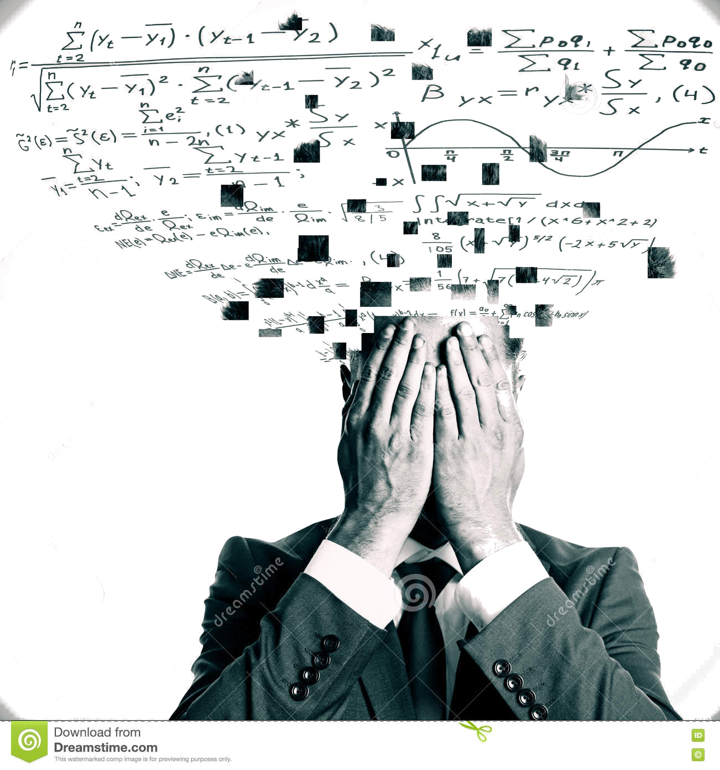
It was a guarantee that
Notes:
https://www.dreamstime.com/stock-illustration-exams-concept-stressed-man-mathematical-formulas-light-background-image80984137

Slide 7
the teacher was not going to get them out of this
Notes:
https://www.dreamstime.com/stock-illustration-exams-concept-stressed-man-mathematical-formulas-light-background-image80984137

Slide 8

the walls shimmered as the room appeared to spin around them

Slide 10
The only way home was down the hallway…

Slide 11

Where In The Universe Is Classroom 205 ?
Play Level / Resume
m =
δ/0
“Imagination is the only weapon in the war against reality.” -- Lewis Carroll
User Login / Create Account
Exit
Notes:
https://commons.wikimedia.org/wiki/File:Euler%27s_infinity_sign.svg

Slide 12
Where In The Universe Is Classroom 205 ?
Play Level / Resume
User Login / Create Account
m =
δ/0
Exit
“Imagination is the only weapon in the war against reality.” -- Lewis Carroll
Notes:
https://commons.wikimedia.org/wiki/File:Euler%27s_infinity_sign.svg

